Slide 1
SUPERMARKET SALES ANALYSIS DASHBOARD
By
Sudha R

Slide 2
Dataset & Tools
Dataset: Supermarket Sales Dataset
Tool Used: Looker Studio (Data Studio)

Slide 3
Project Overview
Objective
Analyze supermarket sales performance.
Identify sales, profit, customer, and product trends.
Build an interactive dashboard for business decision-making.
Dataset
Approximately 1,000 transactions.
Features: Sales, Profit, Branch, City, Product Line, Payment, Customer Type, Rating, Quantity.

Slide 4
Dashboard Overview
Developed an interactive Supermarket Sales Dashboard using Looker Studio.
Monitors key business KPIs including Total Sales, Total Profit, Transactions, Quantity Sold, Average Rating, and Profit Margin.
Provides interactive filters for Date, Branch, City, Product Line, Customer Type, Gender, and Payment Method.
Visualizes sales trends, product performance, branch and city performance, and customer insights.
Includes Top 10 Highest Transactions and key business insights for quick analysis.
Enables stakeholders to make data-driven decisions by identifying sales patterns and business opportunities.

Slide 5
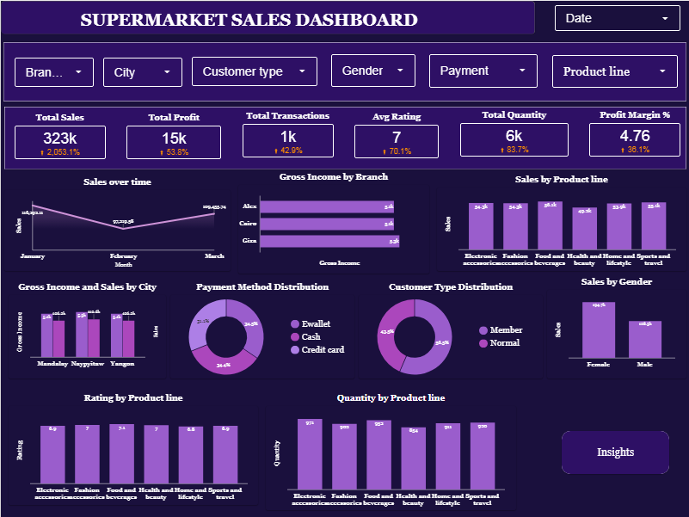

Slide 6
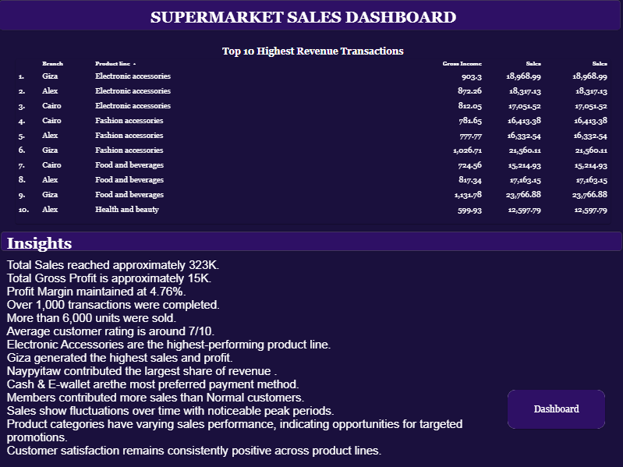

Slide 7
Key Insights
Total Sales: 323K
Total Profit: 15K
Profit Margin: 4.76%
Over 1,000 transactions completed.
Electronics Accessories generated the highest sales.
Giza branch achieved the highest revenue.
Naypyitaw contributed the highest city-wise sales.
Cash and E-wallet were the preferred payment methods.
Members contributed more sales than Normal customers.

Slide 8
Recommendations
Increase inventory for top-selling product lines.
Promote lower-performing categories.
Replicate successful strategies from the top-performing branch.
Encourage customer membership through loyalty programs.
Improve customer satisfaction to increase repeat purchases.

Slide 9
Conclusion
The dashboard provides an interactive view of supermarket performance.
It helps monitor sales, profit, customer behavior, and product trends.
Business stakeholders can use these insights for better inventory, marketing, and operational decisions.

